Slide 1
Power BI Pre-Lab
FSI CSU SWARM

Slide 2
Pre-Lab Module

Slide 3
Abstract and learning objectives
Integrate prerequisite material for this Module

Slide 4
Module
Pre-Lab Module | Create and set-up all materials required for the module.

Slide 5
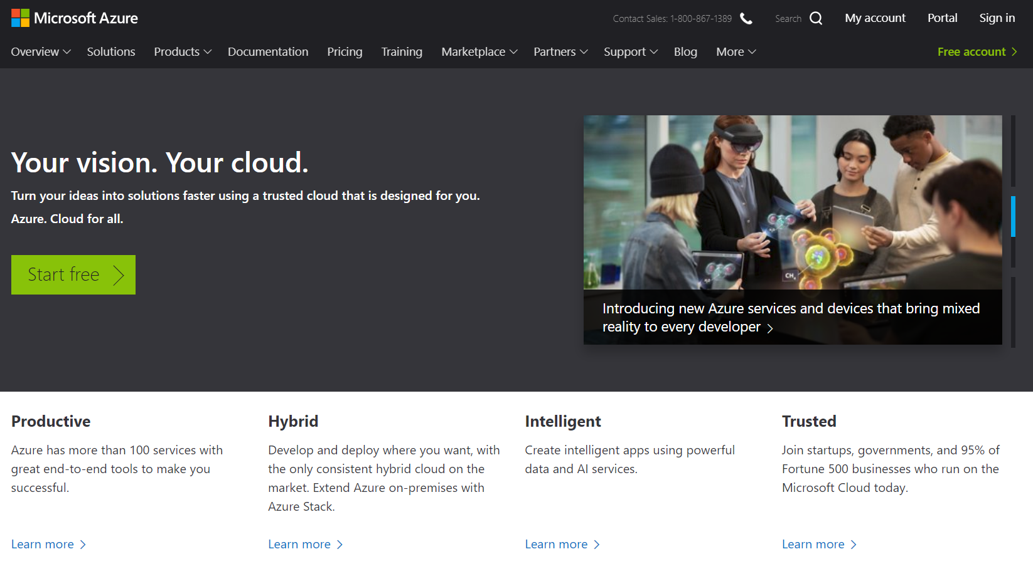
Azure Portal Access
Sign into the Azure Portal or Create a New Account with a free trial

Slide 6
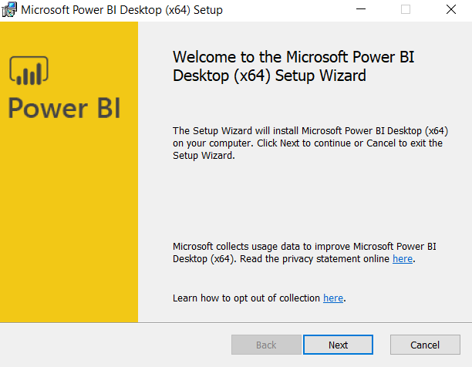
Power BI Desktop
Download and Install Power BI Desktop using this link: Download Link
Installation Instructions
Sign-Into Power BI with your Azure Portal credentials.

Slide 7
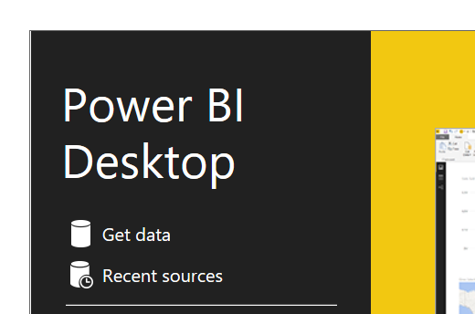
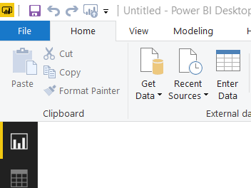
Excel
Download the two Excel files from the GitHub repository onto your local drive
Open Power BI Desktop
Select “Get Data” and then choose “Excel” from the list
Navigate the file explorer to the location of the first Excel files on your local drive and click “Open”
Place a checkbox next to all the Excel sheets to import them all
Repeat steps 4-5 for the second Excel file

Slide 8
Bacpac

Slide 9
Dstx

Slide 10
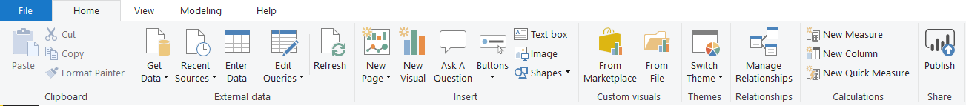
Import Workbook
Download both Workbooks onto your local drive
Open the first Workbook by double-clicking the file (or navigate to File->Open from Power BI and navigate to the .pbix file)
Publish the Workbook to your Workspace by clicking “Publish” in the Quick Access Toolbar and selecting a Workspace available to your account

Slide 11
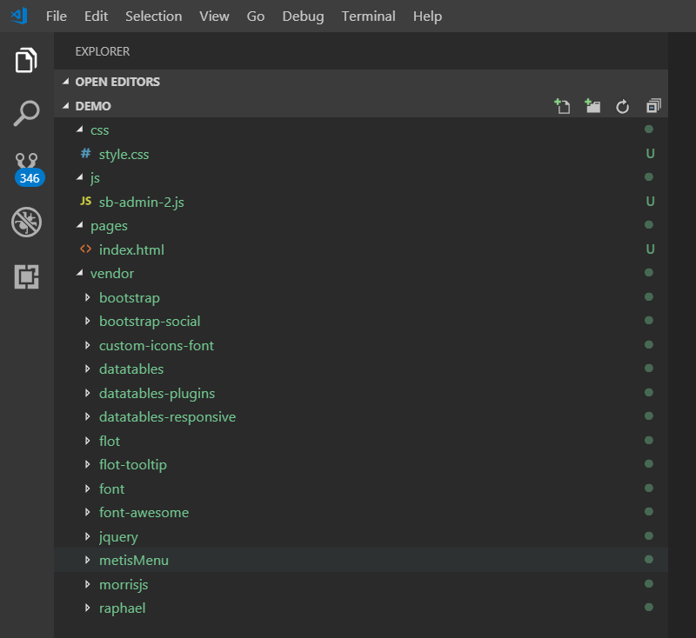
Web App
Download the Web App files onto your local drive
Use Visual Studio Code or your favorite editor to open the Web App folder into the Explorer

Slide 12
Wrap Up

